Slide 2
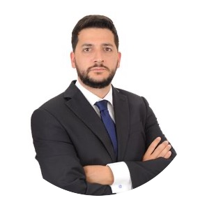
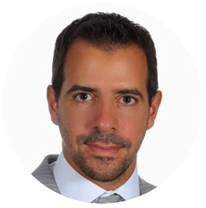
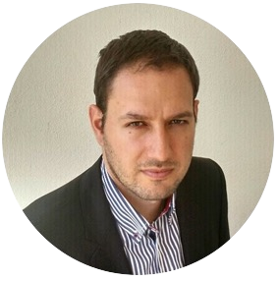
Our team has more than 12 years of experience on technical services arrangements/ troubleshooting and software design
Andreas Minos Zompanakis, CEO
Michael Chartoularis, COO
Achileas Tsoumitas, CTO
Naval Architect & Marine Engineer, MSc Shipping Management ľU Delft with prior experience as ľechnrCal Manager at LNG probunkers, Fleet Manager at Prime Tankers and Superintendent Engineer at AntHony Veder Rederijzaken BV
Naval Architect & Marine Engineer, MBA insead with prior experience as Operations Manager at Amazon.com, DPA at Graham Shipping & Superintendent Engineer at Safe Bulkers & Pleiades Shipping
Electrical & Software Engineer with prior experience rn software design rn JP Morgan, Mckinsey & Company and founder of Desquared

Slide 3
The problem on ships services arrangements
Cost Optimization / Productivity for Ship Managers
Competition insights for service suppliers and incoming requests volume
Prevention / Downtime prevention for Ship Managers
A
B
C
Time consuming process to locate reliable, vetted and most competitive service companies in ports world - wide.
Marine service suppliers have limited access to worldwide ship management companies service requests.
Limited data in competitiveness of service suppliers.
Insufficient root cause analysis of technical issues prior attendance leading to extra costs for service attendances and higher risk for downtime.

Slide 4
The solution
Online digital platform matching service requests with most competitive offers through a global, vetted pool of service suppliers supported by automated technical troubleshooting achieving 14% repair cost savings

Slide 5
Market Size
…
1. Technical Services
- 5 billion USD in yearly services (80k per year per vessel for 75000 ocean going vessels)
2. Technical troubleshooting
-10 hours per ship per month are spent on average technical trouble shooting in an hourly rate of 30 usd. For 75000 ocean going ships leads to a market of 300 million USD annually

Slide 6
Revenue model
Shipmanager
retained service fees on invoice collected from service suppliers
Annual membership fee for service suppliers
Annual membership fee per vessel for ship managers
bid2board
Service supplier

Slide 7
SWOT
…
Strenghts
Team combined expertise in technology and technical shipmanagement
Proved product market fit for our first module
Very small cost for customer acquisition for the next modules since they will possibly be already users of our first products
Threats
Traditional market with resistance to change
Weaknesses
Less digital & tech savvy industry leading to increased requirements for marketing and sales and time to build a solid customer base
Opportunities
Less disrupted industry in digital products with tendencies for gradual shifting in digitalization, leaving an opportunity for new entrants
High customer loyalty in the industry and less risk to switch products leading to higher lifetime value CLV.

Slide 8
Timeline
…
2023
Increase marketing & sales on service arrangement module, increase our clients in Greek and German and North Europe shipmanagment markets
Launch troubleshooting module
Complete design process of drydock module
2024
Expand service and troubleshooting module in UAE and Singapore markets.
Complete design and development and launch of drydock module.

Slide 9
Data & sources
-Current global fleet in numbers
https://www.bimco.org/news/market_analysis/2021/20210624-world_fleet_to_grow_by_slower_in_next_5_years
- Maersk No.1 rn fleet number at 708 ships representing only 1,3% of global fleet as an indication of how fragmented the shipping market is in terms of individual companies, presenting an opportunity for bid2board.

