Slide 1


Energy-as-a-Service
Aimilios Mouchtaropoulos, Co-founder & Chief Marketing Officer
Blue Growth Piraeus| 06^{h} of August 2023

Slide 2


The Problem
Global Waterborne transport:
2-3% of 100% GHG emissions
EU Waterborne Transport:
13% of transport emissions
Potential 50-250% rise by 2050
ΙΜΟ emission reduction targets:
40% by 2030 & 50% by 2050, compared to 2008
Waterborne transport → Οne of the largest contributors to global CO2 emissions.
Lack of Incentives
High Initial Investment
Limited Knowledge
Resistance to Change
Complex Management of Energy Infrastructure
Need
Shipowner & Operator Pains
Cleaner solutions
- 2 -

Slide 3
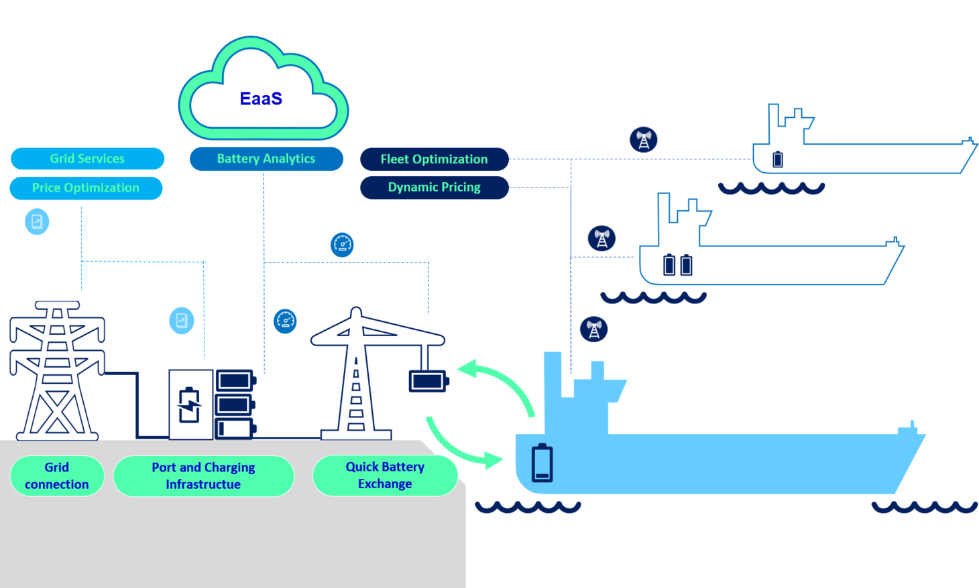
The Solution
- 3 -

Slide 4

The Solution
Innovation
✓ The clean energy needed, when needed, where needed & at a competitive price
✓ Scalability: Potential integration with any alternative fuel
- 4 -

Slide 5




The business model
Energy as a Service
(EaaS)
Pay per use
(PPU)
Revenue Model
Monthly or annual subscription fee
Per-swapping fee charged for battery exchanges
Innovative Business Model
- 5 -

Slide 6






The unique value proposition
What makes EaaS platform unique?
1. Reliable clean energy availability.
2. Zero emission fleet.
3. Reduced vessel’s operational expenses & financial risks. Pricing optimization.
4. Economic viability & competitiveness of alternative solutions.
5. Accessible, sustainable & affordable shipping → Reduction of GHG emissions in the maritime industry.
- 6 -

Slide 7
Development Strategy
Phase 1
Concluded
Research & Conceptualization
Market Research
Competitor Analysis
Business Model Refinement
Phase 2
Under Development
Platform Design & Development
Software Development
Integration with Partners
Phase 3
Planned
Testing & Refinement
Pilot Launch
User Feedback Iteration
Scalability Testing
Launch & Expansion
Full-Scale Launch
Marketing & Sales
Continuous Improvement
Sustainability & Growth
Long-Term Relationships
New Features Development (Based on User Feedback & Market Trends)
Value Proposition Define
- 7 -

Slide 8
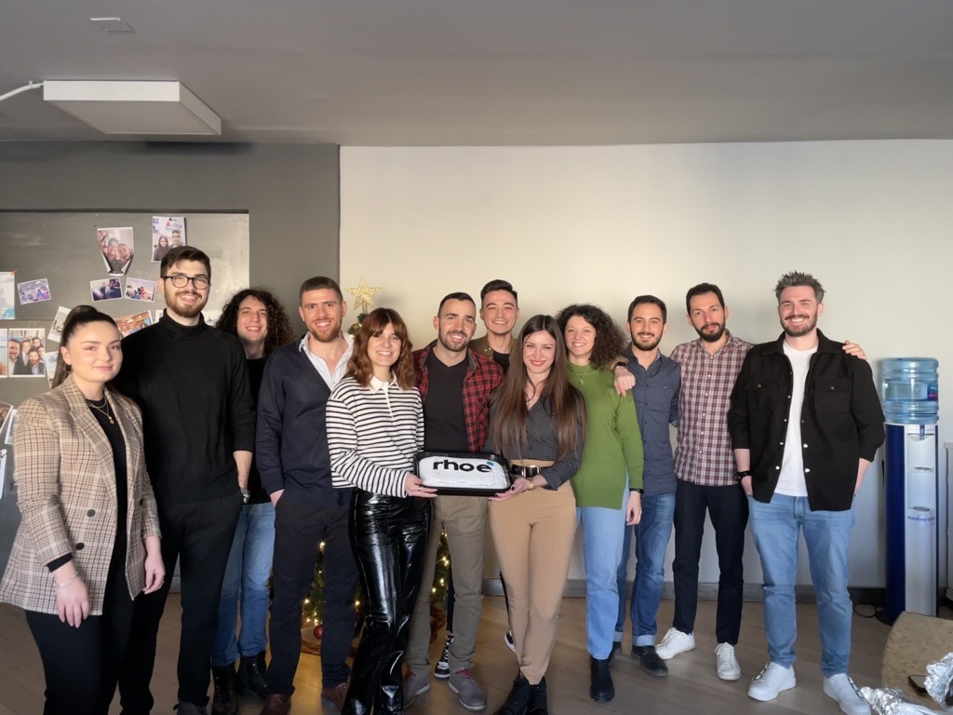
The Team
Advisors
Nikolaos Tsoniotis – Partner, Ideas Forward, serial entrepreneur
Ioannis Politis – Assistant Professor AuTh, Head of Transportation Planning Laboratory
Vasilis Karkatzounis – Legal Counsel, Legal Engineer CIPP/E
- 8 -

Slide 9







Maritime Partners
- 9 -

