Slide 1
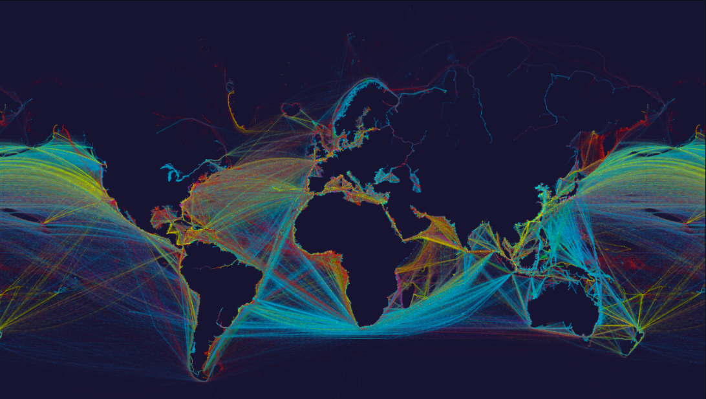
/company/promilist
promilist.com

Slide 2
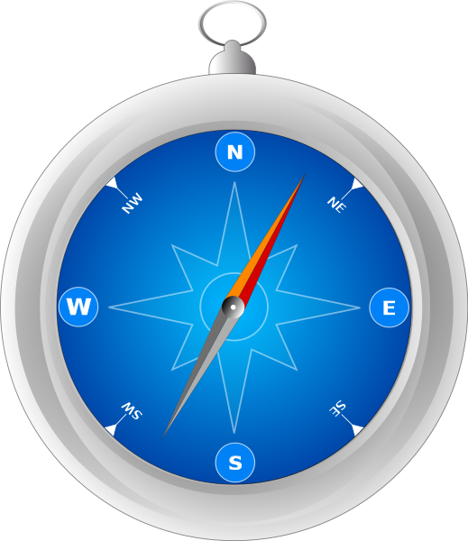
Opportunity
~ 1 Bn Tons of CO2 are emitted each year* by the daily operations of the commercial maritime sector, mostly due to:
Sub-optimal Sea Navigation
Ageing Commercial Fleet
Non-environmentally friendly fuel
*2020 Annual Report on CO2 Emissions from Maritime Transport and summary

Slide 3
Relevant Policy Landscape
2023 → 20%
2024 → 45%
2025 → 70%
2026 →100%
Regulation: Percentage of verified emissions to be paid by the Shipowner
2030 → -40%
Goal: Percentage of emissions to be reduced industry-wide

Slide 4
Problem: Sub-optimal sea navigation
Navigating optimally from one Port to another is a complex, multidimensional problem that depends on:
Weather conditions
Sea currents
Ship specifications
Other constraints (e.g. Piracy Zones)

Slide 5
Redefine voyage optimisation solutions
- Artificial Intelligence
- Earth Observation Data
- Naval Engineering

Slide 6
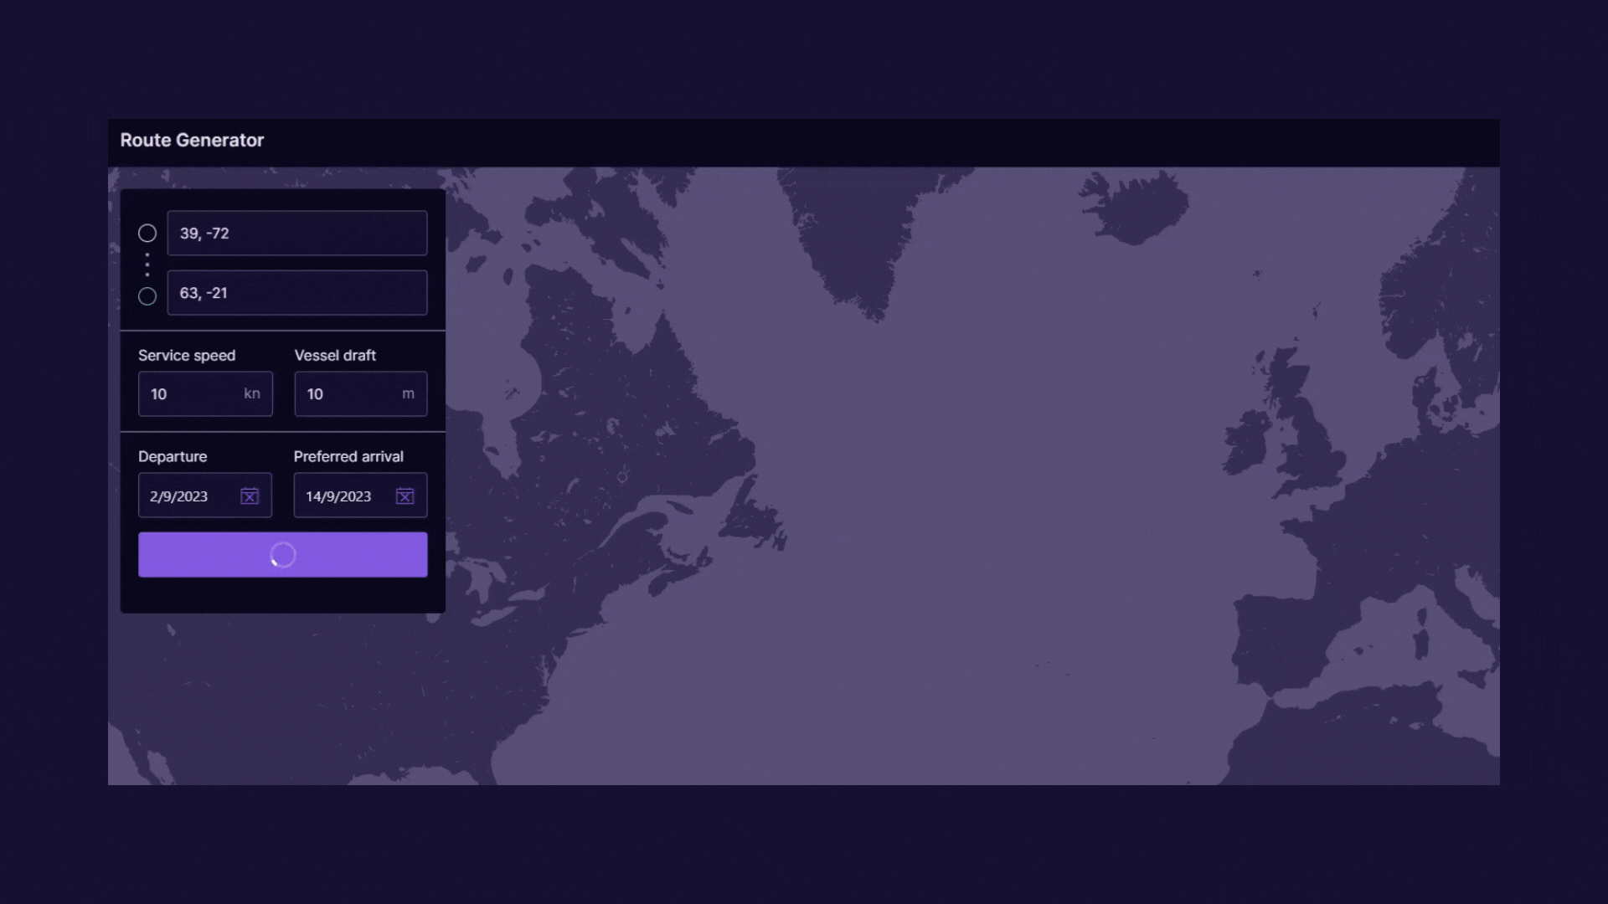
Project "Poseidon" - Case Study
Legend
14% Savings for Demo Transatlantic Trip
Orthodrome (Shortest Distance)
Realtime, weather optimized route generated by our algorithm

Slide 7
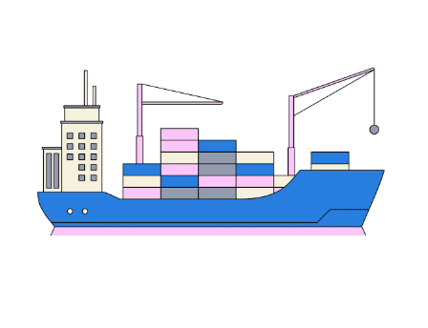
Solution: Use Cases & Customer Segments
Charterers & Charter-party claims
Brokers
Captains
Operators

Slide 8
Value proposition (Impact)
The maritime sector can function more efficiently while addressing climate change

Slide 9
Competition
Accuracy
Black Box Approach regarding Performance
Bespoke SFOC Model based on Vessel Specs

Slide 10
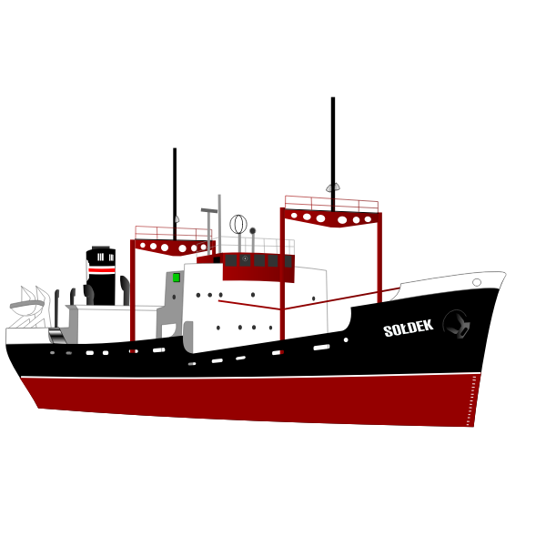
1
Product development scope; we managed to have a fully commercial MVP/Beta version of our product, ready to be tested by our first potential customers.
2
Market traction; we are in a closed-beta period, in the process of conducting pilot experiments with potential clients/partners.

Slide 11
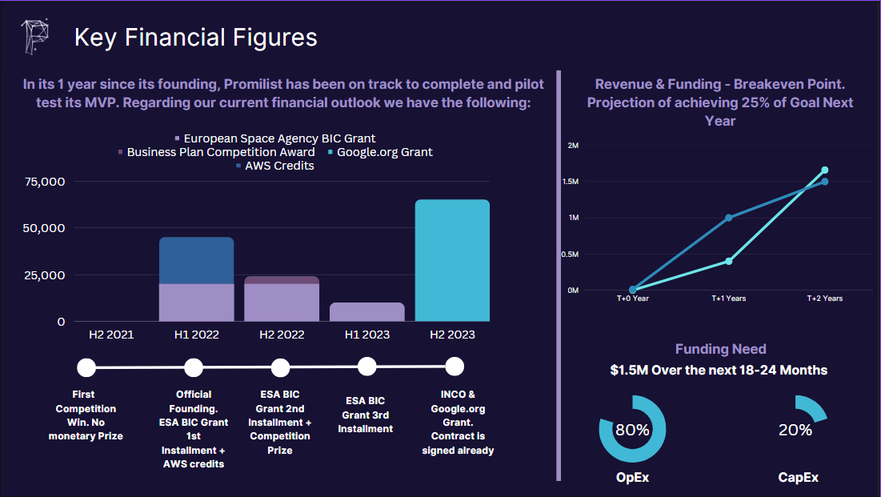

Slide 12
Market
Total Addressable Market: The Global Commercial Fleet
~8% (of Global)
1% (of Greek)
52818
4648
46
Global Commercial Fleet
Greek-owned Fleet
Next Year Target
12
*source: Review of Maritime Transport, UNCTAD, January 2020

Slide 13
Business Model
A subscription based model, per vessel, per month
46
$36000
$1.66M
1st Year Goal
Average Yearly Fee per Vessel
Revenue
Estimation for Next Year
13

Slide 14
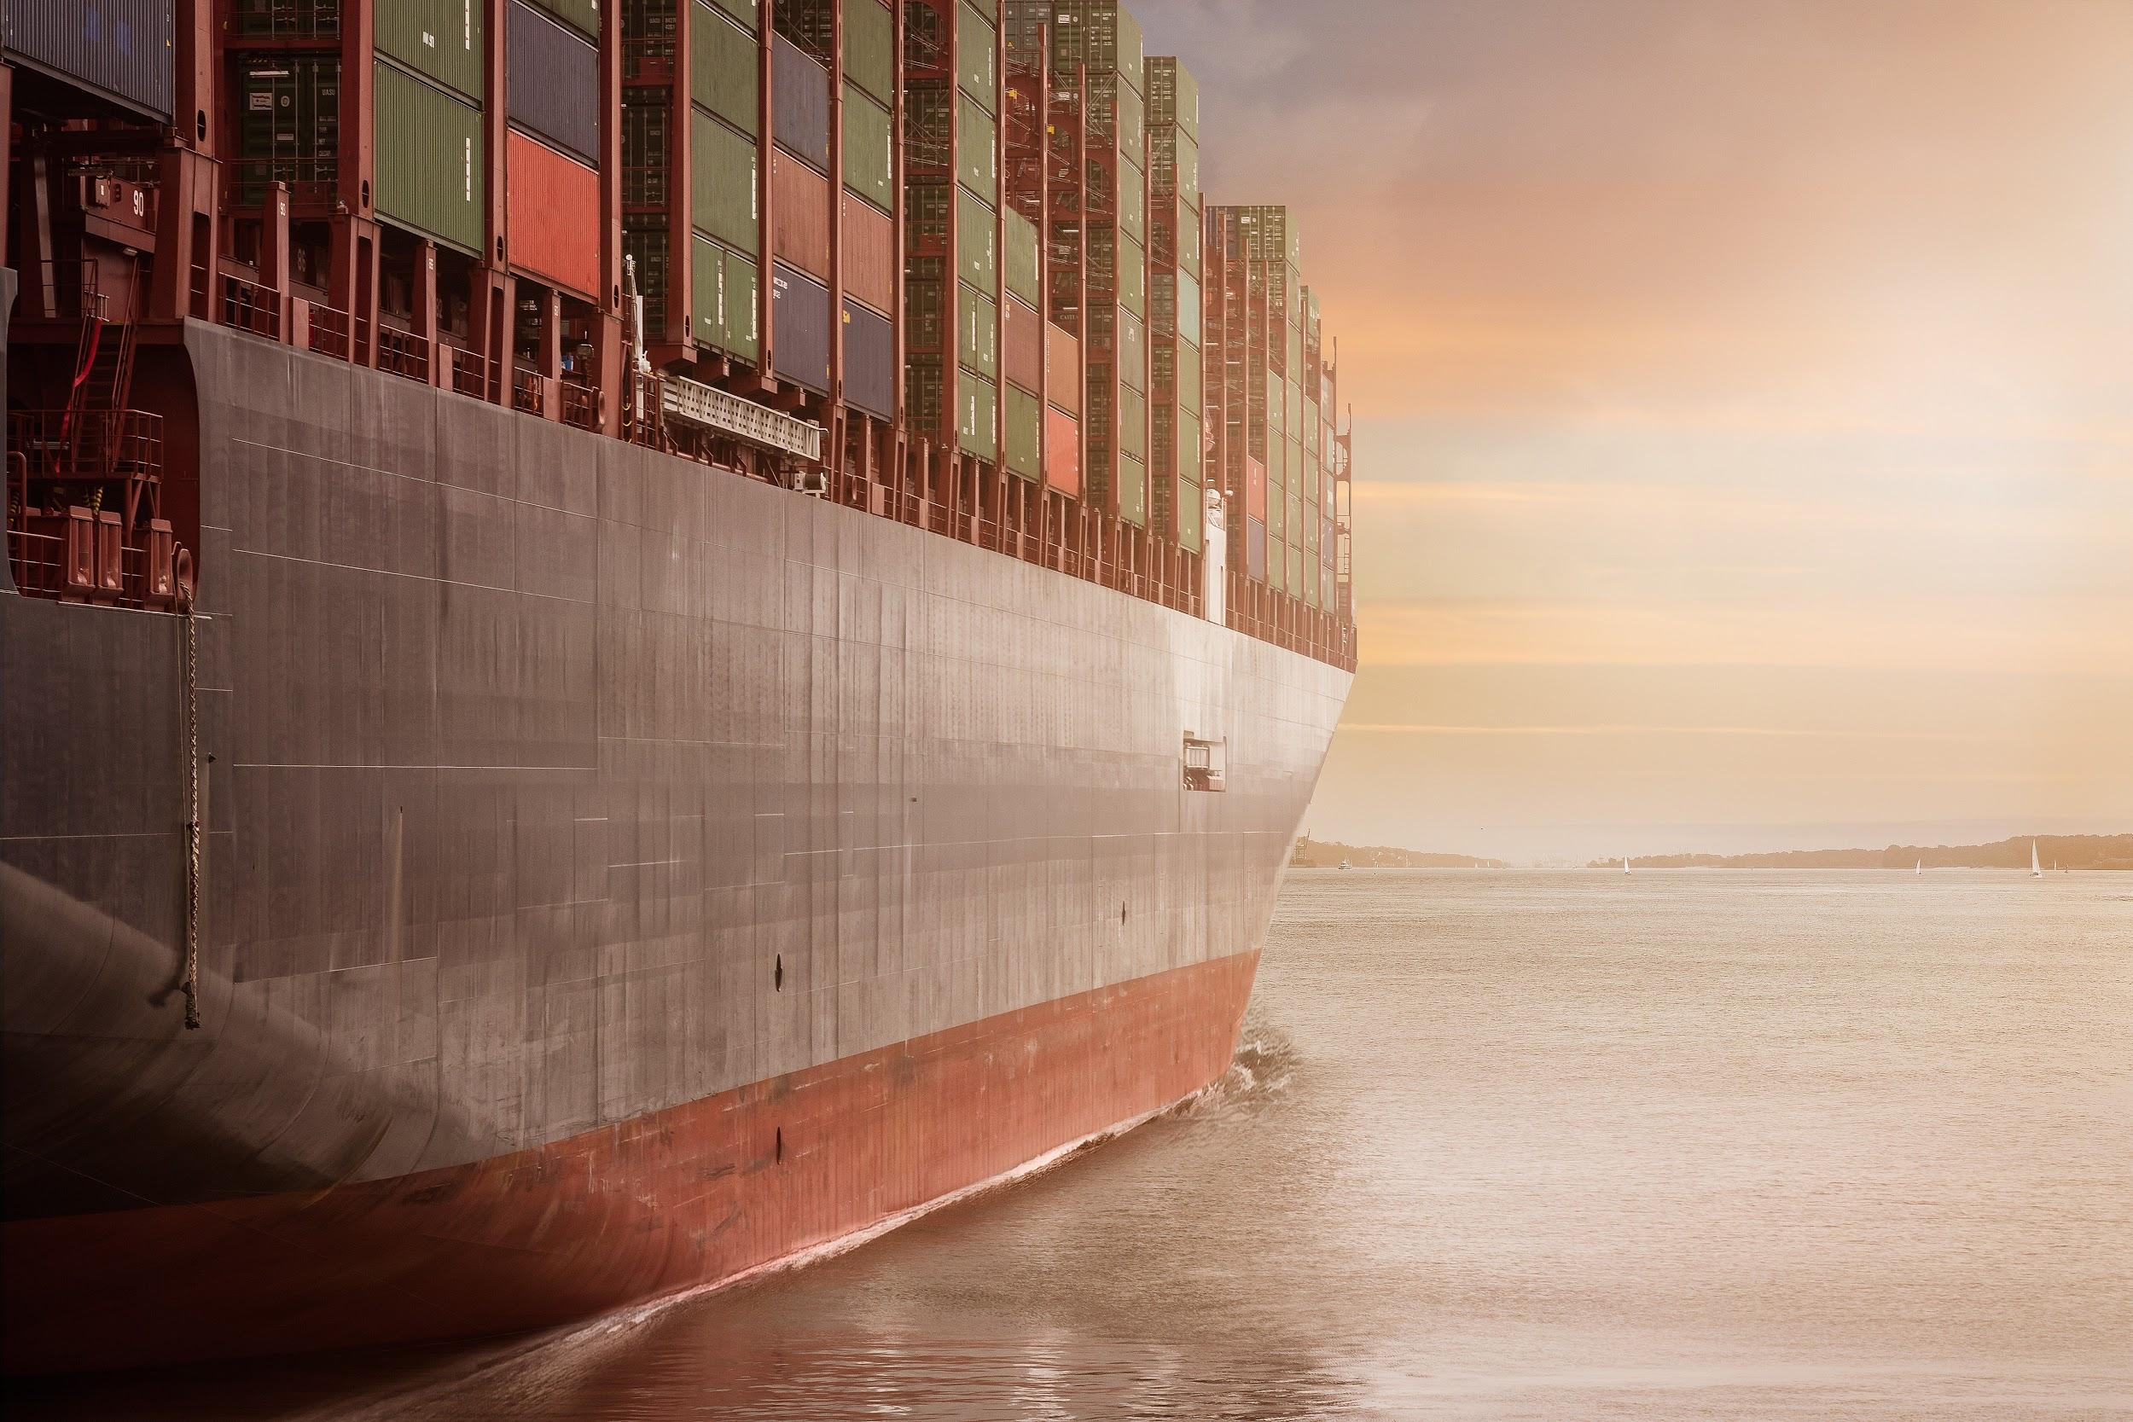
Future Roadmap
HSE & Incidents Module
CII & EEXI Prediction
Hull Fouling Monitoring
Inhouse Weather Forecasting
Expansion outside Maritime (e.g., Aerospace)
Weather Routing as a Service
PHASE I- Project Poseidon
PHASE II - 360 Service provider
PHASE III - Rerouting the World

Slide 15
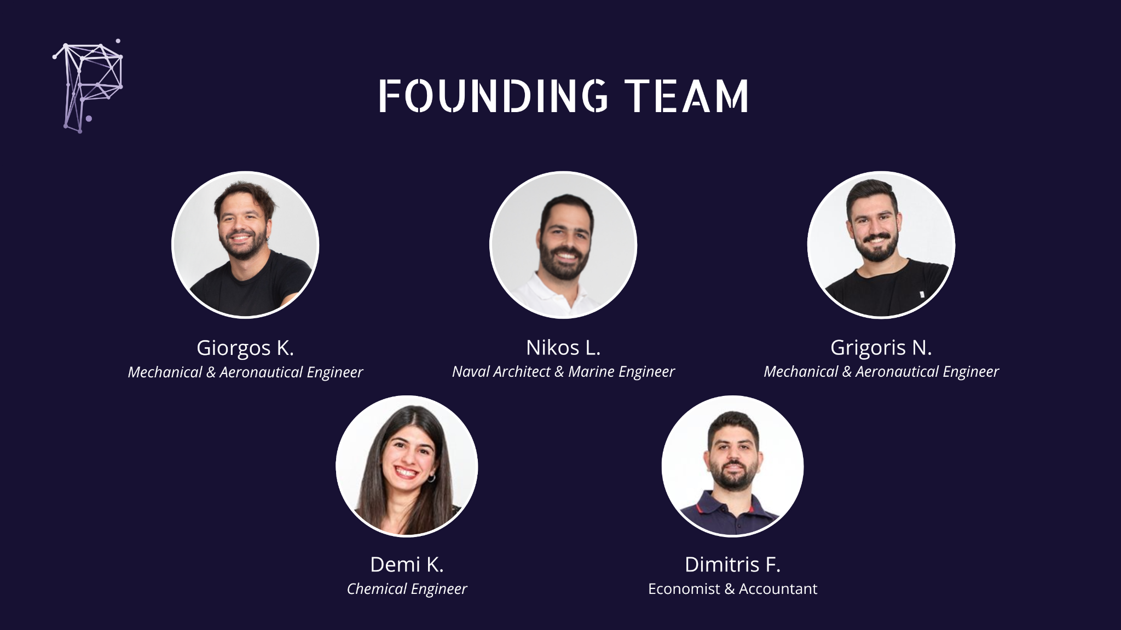

Slide 16
Partners - Supporters - Awards

Slide 17
Thank you!
/company/promilist
promilist.com
info@promilist.com

Slide 18
Value proposition: Accuracy - Case Study
- Geodesic example (without uncertainty factors such as weather and vessel performance model) -
Our solution
Commercial “graph-based” solutions
Relative Error between the analytical and NN solution = 2.1E-7%
At the maximum point, the deviation is half the width of Greece (≈ 300 km)

Slide 19
Competition
Features/Competitors
Continuous Approach to Optimization Problem which provides high resolution Solutions | ✅ | ❌ | ✅
Bespoke SFOC model based on Vessel Specs | ❌ | ✅ | ✅
Plug & Play structure, compatible with different weather providers, data sources and vessel data formats | ❌ | ❌ | ✅

